Slide 1
Architectural Patterns
© Lethbridge/Laganière 2001
Chapter 9: Architecting and designing software
1/26

Slide 2
Architectural Patterns
‘Notion’ of an architectural pattern is essential to good architectural design.
  We call these architectural patterns or architectural styles.
  Patterns provide for flexible systems using components
    Components are as independent as possible. (Hunks of executable components…)
  Some architectural patterns are better far better for some applications than for others.
  Let’s look at a few important ones.
© Lethbridge/Laganière 2001
Chapter 9: Architecting and designing software
2/26

Slide 3
1. The Multi-Layer Architectural Pattern
Layered architecture:
    layers communicate down!
    Normally immediately below with few ‘skips’
    Is the classical approach.
    The higher layer sees the lower layers as a set of services.
    This notion is fundamental to good design.
    Often, a layer communicates ONLY with the layer below it not always - but normally.
    .
© Lethbridge/Laganière 2001
Chapter 9: Architecting and designing software
3/26

Slide 4
Multi-Layered Architectural Pattern…
  Built with layers at increasing levels of abstraction.
    1. User Interface layer - normally first for presentation
    2. Application Layer is usually immediately below UI layer and typically provides the application functions determined by application use-cases. (application layer)
    3. Domain Layer is usually next and provides general domain-level services (business use-cases)
    4. Services / Support (Bottom) layers provide general (but essential) services.
        e.g. network communication, database access
        operating system services
© Lethbridge/Laganière 2001
Chapter 9: Architecting and designing software
4/26

Slide 5
Extremely Nice Feature of Layered Design
    Layers / layer services are replaceable
      NO impacting to other layers and dependencies
      if the interfaces remains unchanged.
      Examples:
        User Interface layer when porting to a different platform or for different environments.
        Upgrading / enhancing / optimizing services…
      We have clear separation of concerns
      We have very good ‘cohesion’ of services…
© Lethbridge/Laganière 2001
Chapter 9: Architecting and designing software
5/26

Slide 6
Example Of Multi-layer Systems (Seen Before…)
Application programs
Screen display
facilities
Dealing with
application protocols
User account
User
management
Dealing with
interface
connections
File
Application
system
Dealing with
logic
packets
Kernel
Operating system
Database
Network
(handling processes
Transmitting
access
access
communication
and swapping)
and receiving
a) Typical layers in an
b) Typical layers in an
c) Simplified view of layers
application program
operating system
in a communication system
Communications between layers: usually use procedure calls.
Upper layers become clients; lower layers become servers.
© Lethbridge/Laganière 2001
Chapter 9: Architecting and designing software
6/26

Slide 7
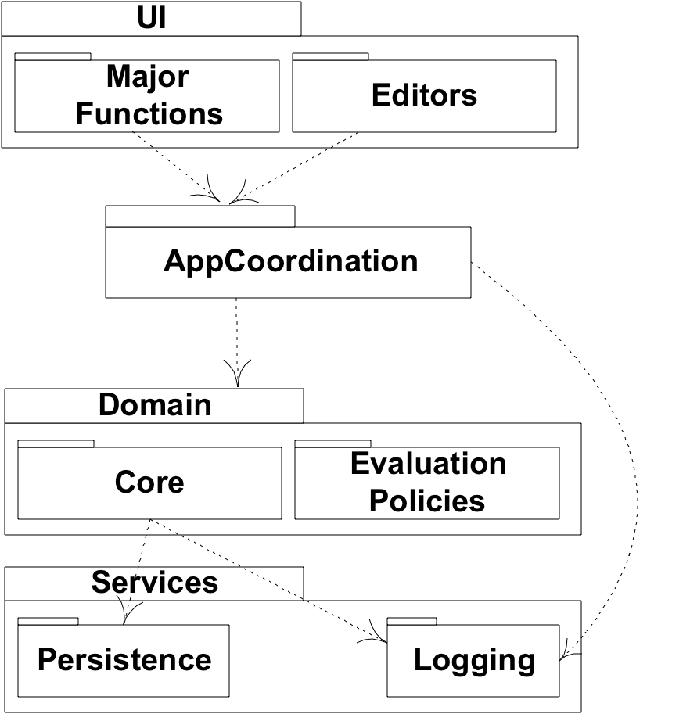
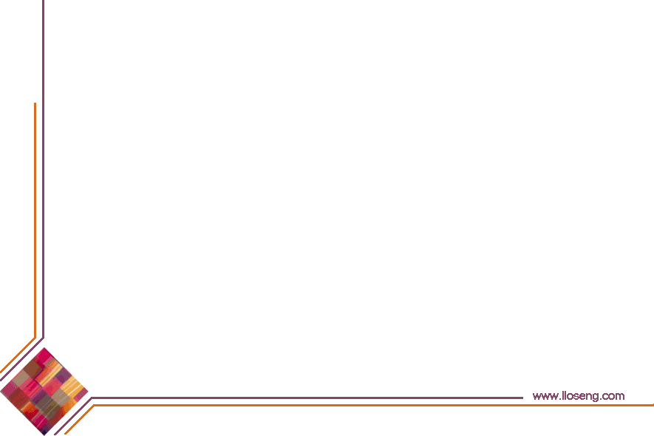
Multi-Tier Layered Architecture - Example
© Lethbridge/Laganière 2001
12

Slide 8
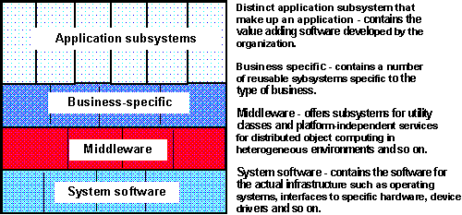
Multi-Tier Layered Architecture - Example Layering Approach
Specific functionality
General functionality
This is a very broad generalization. in practice, things will be
considerably different and application dependent in many cases.
Note: this is also a very general view; may/may not include a GUI layer.
© Lethbridge/Laganière 2001
6

Slide 9
Multi-Tier Layered Architecture - Example
Separate presentation and application logic, and other areas of concern.
Consider: Different names (in some cases). Can see the main idea!
UI Layer (or Presentation Layer)
(Interface may/may not be graphical…)
“Domain” or “Application Logic” Layer
(May/may not need both…)
Services Layer
Persistence
Subsystem
Logging
Subsystem
Security
Subsystem
© Lethbridge/Laganière 2001
8

Slide 10
Multi-layered Architecture And Design Principle Satisfy Eleven Architectural Design Principles)
  1. Divide and conquer: layers can be independently designed.
  2. Increase cohesion: Well-designed layers have layer cohesion.
  3. Reduce coupling: Well-designed lower layers do not know about the higher layers and the only connection between layers is through the API.
  4. Increase abstraction: you do not need to know the details of how the lower layers are implemented.
  5. Increase reusability: The lower layers can often be designed generically. (e.g. those that handle database access, persistency, etc.) (different databases….)
© Lethbridge/Laganière 2001
Chapter 9: Architecting and designing software
7/26

Slide 11
Multi-layered Architecture And Design Principle Satisfy Eleven Architectural Design Principles)*
  6. Increase reuse: You can often reuse layers built by others that provide the services you need. (think: Domain Layer)
  7. Increase flexibility: you can add new facilities built on lower-level services, or replace higher-level layers.
  8. Anticipate obsolescence: By isolating components in separate layers, the system becomes more resistant to obsolescence.
  9. Design for portability: All the dependent facilities can be isolated in one of the lower layers.
  As we know, some things tend to change over time; more than some other aspects of an application.
  10. Design for testability: Layers can be tested independently through the interfaces exercising layer responsibilities.
  11. Design defensively: The APIs of layers are natural places to build in rigorous assertion-checking.
  Note that this model appears to satisfy all eleven design principles!
© Lethbridge/Laganière 2001
Chapter 9: Architecting and designing software
8/26

Slide 12
Client-server and other Distributed Architectural Patterns
  At least one component has the role of server:
    waiting for and then handling connections.
  At least one component that has the role of client, initiating connections to obtain some service.
  Three-tier model for web-based client-sever applications:
    Server ‘in the middle’
      server to client (web-based or not; likely communicating via the Internet)
      client to a database server (usually / often via an intranet)
© Lethbridge/Laganière 2001
Chapter 9: Architecting and designing software
9/26

Slide 13
Other Distributed Client-server Architectural Patterns
  Peer-to-Peer pattern. A system where:
    various software components distributed over several hosts.
    Hosts: both clients and servers (to each other)
    Any two components can set up a communications channel through which communications is accomplished.
  Variation:
    Sometimes peers need to be able to find each other;
    May need a server containing location information
© Lethbridge/Laganière 2001
Chapter 9: Architecting and designing software
10/26

Slide 14
An Example Of A Distributed System
Client1:
<<communication>>
look up addresses
<<communication>>
exchange messages
<<communication>>
Server:
exchange messages
Client2:
<<communication>>
<<communication>>
look up addresses
exchange messages
Client3:
© Lethbridge/Laganière 2001
Chapter 9: Architecting and designing software
11/26

Slide 15
How Does The Client-server Architectural Pattern Subscribe To Principles Of Good Architectural Design?
  1. Divide and conquer: Dividing the system into client and server processes is a strong way to divide the system.
    ➔ Each can be separately developed.
  2. Increase cohesion: Server can each provide cohesive services to clients.
  3. Reduce coupling: There is usually only one communication channel exchanging simple messages.
  4. Increase abstraction: Separate distributed components are often good abstractions. What does this sentence mean to you? Abstractions??
  6. Increase reuse: It is often possible to find suitable frameworks on which to build good distributed systems. Sample architectures already exist. However, client-server systems are often very application specific.
© Lethbridge/Laganière 2001
Chapter 9: Architecting and designing software
12/26

Slide 16
3. The Broker Architectural Pattern
  Here, we transparently distribute aspects of the software system to different nodes
    Objects call method’s other objects w/o knowing object is remotely located.
    Client does not ‘care’ where the remote object is.
    CORBA: well-known open standard allowing you to build this kind of architecture.
      (Common Object Request Broker Architecture)
      (Microsoft has its own architecture: COM, DCOM (old))
      ‘Proxy design pattern’ can be used such that a proxy object calls the broker, which determines where the desired object is located.
© Lethbridge/Laganière 2001
Chapter 9: Architecting and designing software
14/26

Slide 17

Example of a Broker system
Very popular design pattern. Simple and very effective.
Note that all these architectural patterns are illustrated using ‘components.’
© Lethbridge/Laganière 2001
Chapter 9: Architecting and designing software
15/26

Slide 18
Broker Architecture And How This Architectural Design Pattern Subscribes To Design Principles
  1. Divide and conquer: The remote objects can be independently designed.
  5. Increase reusability: It is usually possible to design the remote objects so that other systems can use them too. We see this all the time on the Internet.
  7. Design for flexibility: The brokers can be updated as required, or the proxy can communicate with a different remote object.
  9. Design for portability: You can write clients for new platforms while still accessing brokers and remote objects on other platforms.
  11. Design defensively: You can provide careful assertion checking in the remote objects.
  Note that there are fewer design principles satisfied. Does NOT make this pattern inferior! (coherence; coupling; obsolescence, more…)
© Lethbridge/Laganière 2001
Chapter 9: Architecting and designing software
16/26

Slide 19
4. Transaction-Processing Architectural Pattern
A process reads a series of inputs one by one.
  Each input describes a transaction – a command that typically (for example) might change some data stored by the system
  Normally transactions come in one-by-one. generally atomic.
    Do this, then that, then another thing. Add, Change, Delete…
  A transaction dispatcher briefly processes a transaction and ‘hands’ that transaction to a specific transaction handler designed to specifically ‘handle’ that kind of transaction.
  The transaction handler is specifically designed and implemented to handle ‘a’ specific type of transaction.
© Lethbridge/Laganière 2001
Chapter 9: Architecting and designing software
17/26

Slide 20
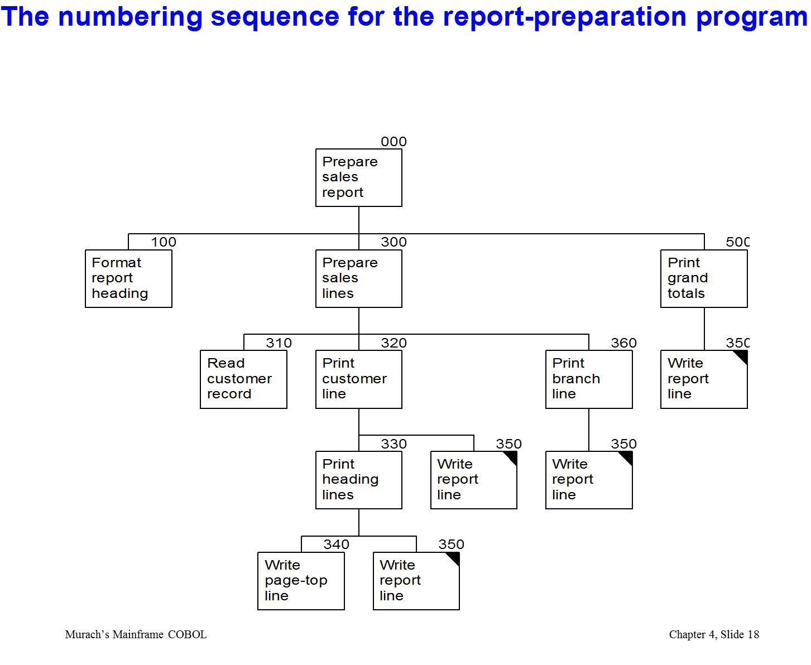
Transactions within a single program architecture

Slide 21
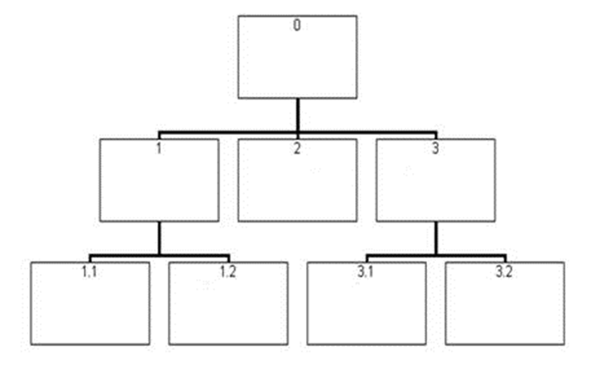

Slide 22
Transaction Dispatchers – Some Complexity
Comments:
  In a threaded environment, where many transactions may be ‘in process,’ data to be modified must be locked and released as appropriate. Additional complexity.
  Particularly complicated when an application needs to perform a query prior to an update transaction all the while ensuring that the data is not changed…
  See database books on the details. (record / attribute lockout)
© Lethbridge/Laganière 2001
Chapter 9: Architecting and designing software
18/26

Slide 23
Example of a Transaction-Processing System
At a higher level – the application architecture rather than a program architecture:
Handler for
Reservation
Transaction
transactions
Transaction
transaction
input
dispatcher
Handler for
Flight cancellation
transaction
Recognize that these ‘components’ might exist on a local device or remotely.
The ‘component’ may simply be an implementation of some design subsystem.
© Lethbridge/Laganière 2001
Chapter 9: Architecting and designing software
19/26

Slide 24
The Transaction-Processing Architecture And Design Principles (As Usual, These Are Very Good..)
  1. Divide and conquer: The transaction handlers are suitable system divisions that can be given to separate software engineers for detailed design and development.
  2. Increase cohesion: Transaction handlers are naturally cohesive units.
  A ‘hander’ accommodates only ‘that’ transaction.’
  3. Reduce coupling: Separating the dispatcher from the handlers clearly reduces coupling.
  7. Design for flexibility: One may readily add new transaction handlers to handle additional transactions.
  11. Design defensively: One may add assertion checking in each transaction handler and/or in the dispatcher.
  Note: several principles missing here too….Design Decisions!!
© Lethbridge/Laganière 2001
Chapter 9: Architecting and designing software
20/26

Slide 25
5. The Pipe-and-Filter Architectural Pattern
Streams of data, in a relatively simple format, passed through series of processes
  Data constantly fed into a pipeline; Each component transforms the data in some way.
  The processes work concurrently. Constant data in and coming out.
  Very flexible architecture.
    Almost all the components could be removed.
    Components may added, changed, deleted, reordered…
  Very flexible particularly (for example) as in converting data or filtering out (removing) characters or ‘features’, etc.
  Sometimes (oftentimes) data might undergo a series of transformations…
  Can also split pipelines or join pipelines together.
© Lethbridge/Laganière 2001
Chapter 9: Architecting and designing software
21/26

Slide 26
Example Of A Pipe-and-filter System
One pipe starts here…
encoders for
microphones
Note the concurrency…
microphone
near
input
sound
source
Pipelines join here
cancel
cancel
remove
equalize
echo
noise
non-voice
dynamic
compress
transmit
frequencies
range
TCP/IP Transmission
encoder for
distant
ambient
encode
microphone
noise
speaker
decompress
receive
Another pipeline starts here…
output
Think in terms of manufacturing processes, process control applications
or a GPS system.
Used more frequently in scientific/engineering systems than in information
systems applications.
Note: questionable architecture for an information system….
© Lethbridge/Laganière 2001
Chapter 9: Architecting and designing software
22/26

Slide 27
Pipe-and-Filter Architecture: Design Principles
  1. Divide and conquer: The separate processes can be independently designed. Excellent for manufacturing / process control / etc. systems.
  2. Increase cohesion: The processes have functional cohesion. (single input; single output; no side effects…)
  3. Reduce coupling: The processes have only one input and one output.
  4. Increase abstraction: The pipeline components are often good abstractions, hiding their internal details. And components are usually replacable!
  5. Increase reusability: The processes can often be used in many different contexts.
  6. Increase reuse: It is often possible to find reusable components to insert into a pipeline.
© Lethbridge/Laganière 2001
Chapter 9: Architecting and designing software
23/26

Slide 28
6. The Model-View-Controller (MVC) Architectural Pattern
Architectural pattern to help separate user interface layer from other parts of the system
Great way to have layered cohesion, as interfaces or controlled.
Coupling reduced between UI layer and rest of system.
Very popular architectural pattern….
THE MVC pattern separates the
  Model: the functional layer (business entities, ‘key
  abstractions,’ the objects, relations, ...) from the
  View: the user interface and the
  Controller; the director / sequencer of the activities in response to the user.
  Why are the business entities called the Model??
© Lethbridge/Laganière 2001
Chapter 9: Architecting and designing software
24/26

Slide 29
MVC Architectural Pattern
  The model contains the underlying classes whose instances (objects) are to be viewed and manipulated
    Model will likely contain classes from the business domain that may be general and form the application itself (may be inherited) , which may be unique or specialized to the application.
    These may be very complicated software objects.
  The view contains objects used to render the appearance of the data from the model in the user interface and the controls with which an actor can interact.
  The controller contains the objects that control and handle the user’s interaction with the view and the model.
    Controller contains business logic…and response to events.
  (The Observable design pattern is normally used to separate the model from the view (later) )
© Lethbridge/Laganière 2001
Chapter 9: Architecting and designing software
25/26

Slide 30
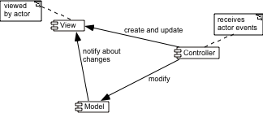
Example of the MVC architecture for the UI
MVC exhibits layered cohesion, as the model has no idea
what view and controller are attached to it (doesn’t care!).
Model is ‘passive’ in this respect.
The View (UI), business services (controller), and model
(business entities / core abstractions) will reside in different architectural layers.
Discuss the arrows…and their directions…
(from perspective of the
Controller…)
There may be special cases when no controller component is created, but
the separation of the model from the view is still essential.
© Lethbridge/Laganière 2001
Chapter 9: Architecting and designing software
26/26

Slide 31
The MVC Architecture and Design Principles
  1. Divide and conquer: Three components can be somewhat independently designed.
  2. Increase cohesion: Components have stronger layer cohesion than if the view and controller were together in a single UI layer.
  3. Reduce coupling: Minimal communication channels among the three components.
  6. Increase reuse: The view and controller normally make extensive use of reusable components for various kinds of UI controls.
  7. Design for flexibility: It is usually quite easy to change the UI by changing the view, the controller, or both.
  10. Design for testability: Can test application separately from the UI.
Know
These!
© Lethbridge/Laganière 2001
Chapter 9: Architecting and designing software
27/26

